Slide 1
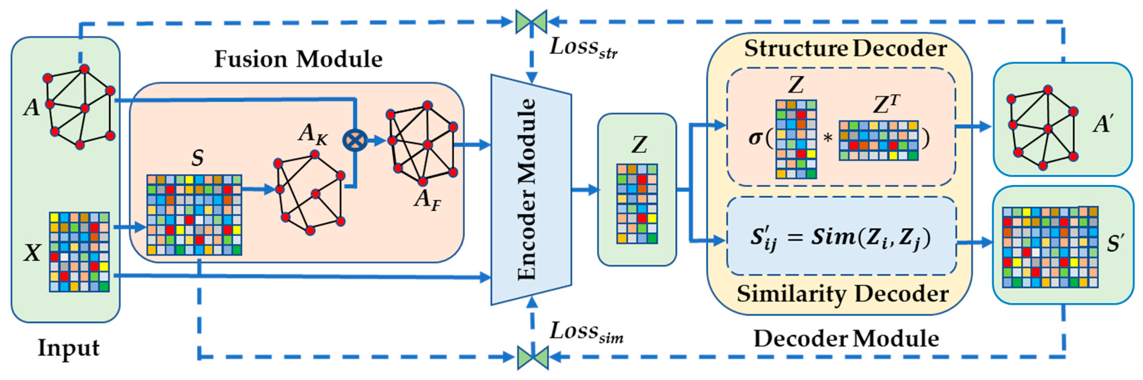
Graph (AUTOENCODER Y VARIACIONAL AUTOENCODERS)
Jonnatan Arias Garcia

Slide 2
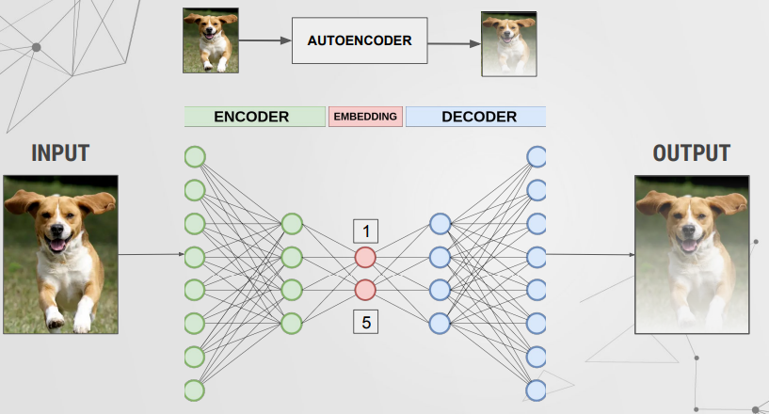
AutoEncoder

Slide 3
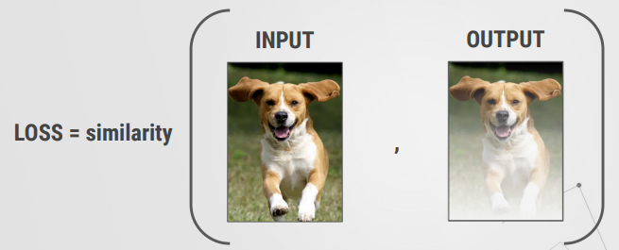
AutoEncoder

Slide 4
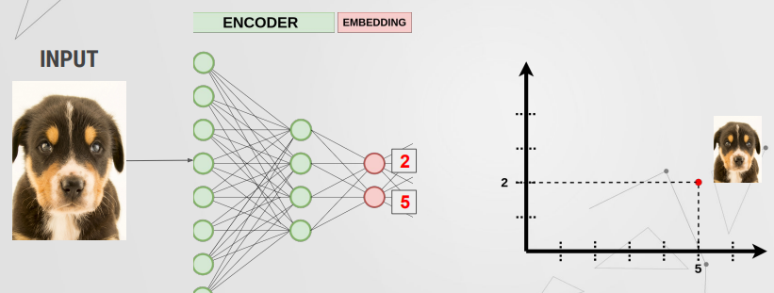
AutoEncoder (embedding space)

Slide 5
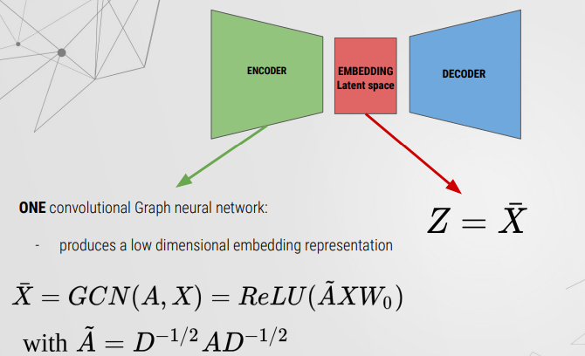
Graph AutoEncoder (encoder)

Slide 6
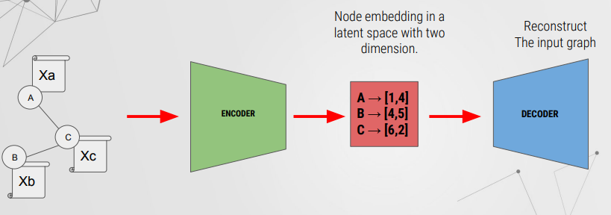
Graph AutoEncoder

Slide 7
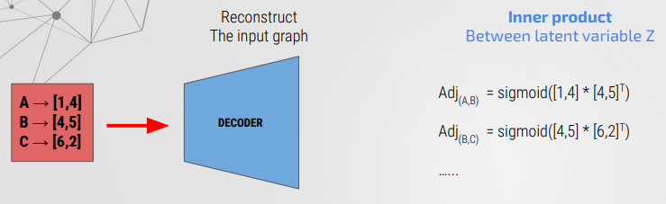
Graph AutoEncoder (decoder)

Slide 8
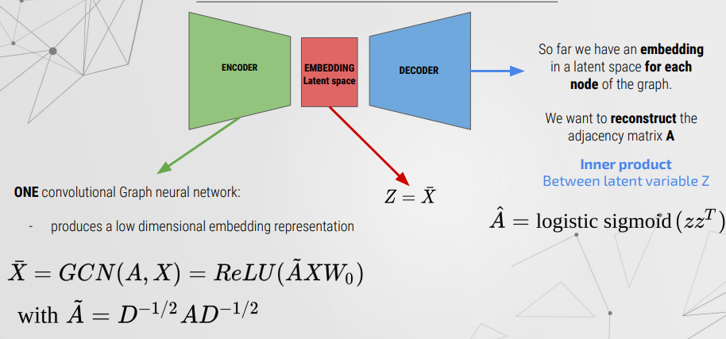
Graph AutoEncoder (decoder)

Slide 9
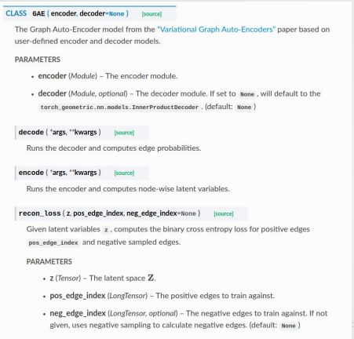
GAE en PyG

Slide 10
Variational GAE

Slide 11
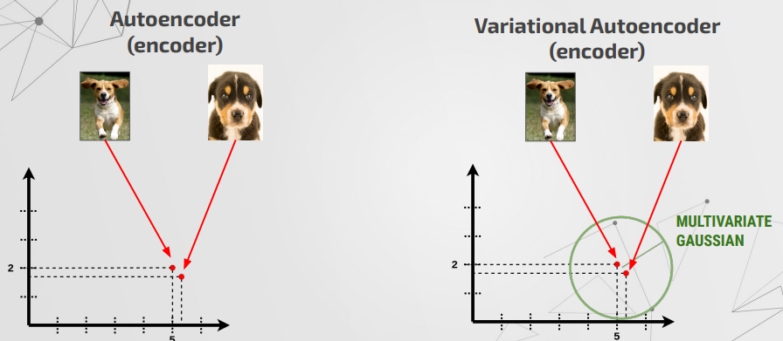
Variational AutoEncoder

Slide 12
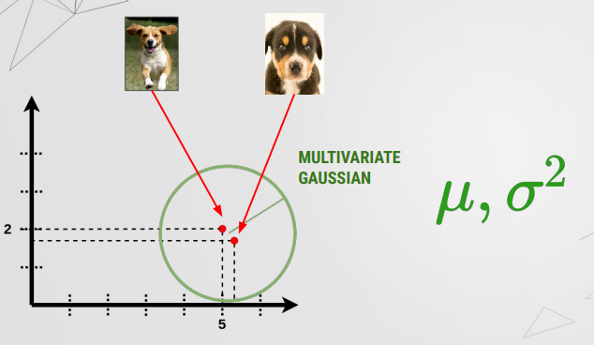
Variational AutoEncoder

Slide 13
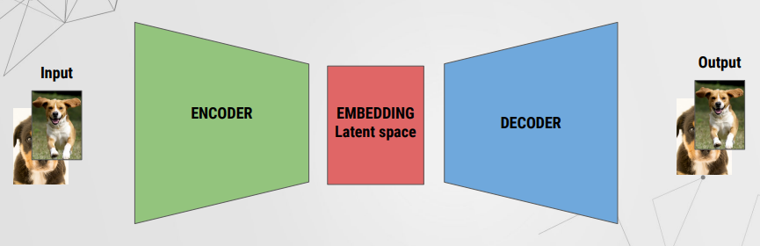
Variational AutoEncoder

Slide 14
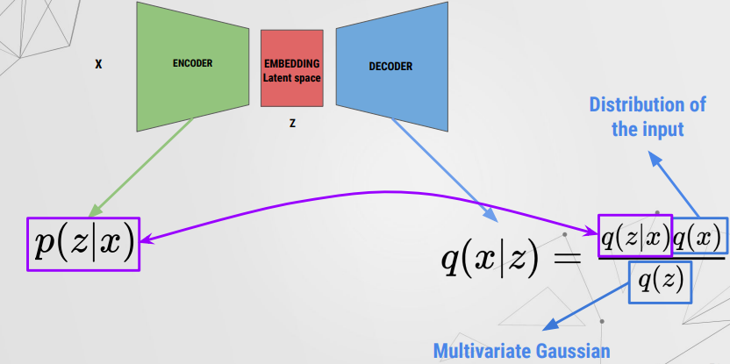
Variational AutoEncoder

Slide 15
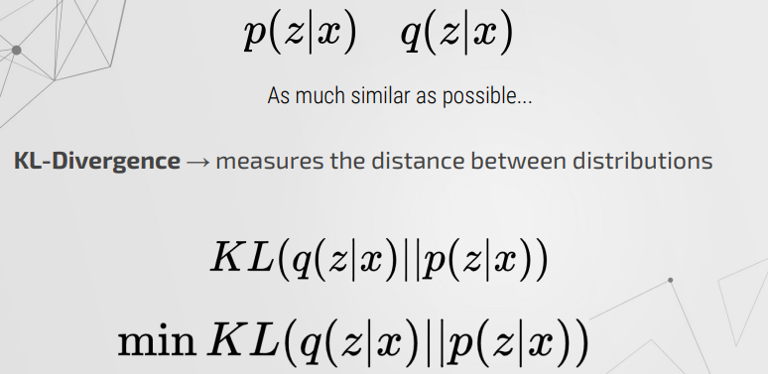
Variational AutoEncoder

Slide 16
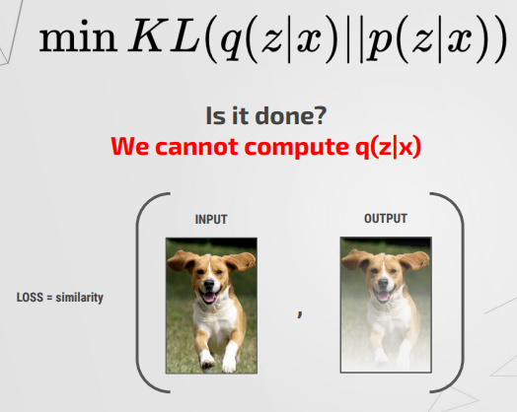
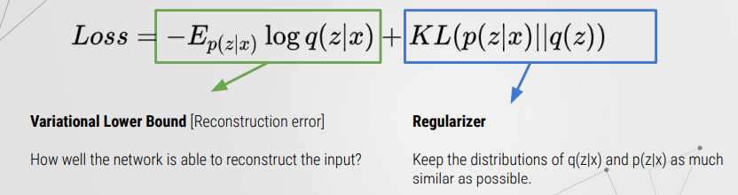
Variational AutoEncoder

Slide 17
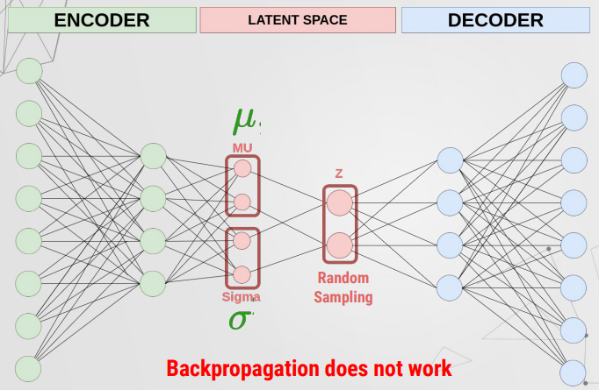
Variational AutoEncoder

Slide 18
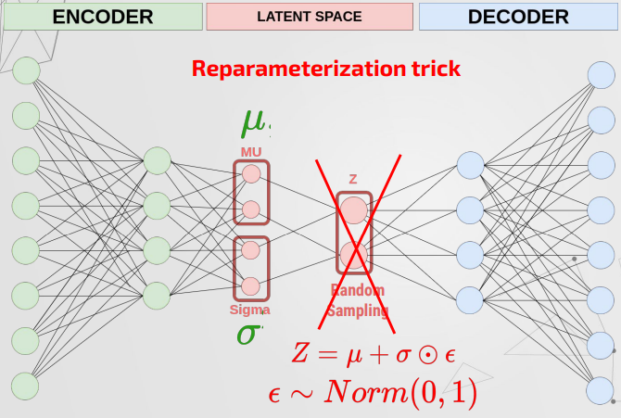
Variational AutoEncoder

Slide 19
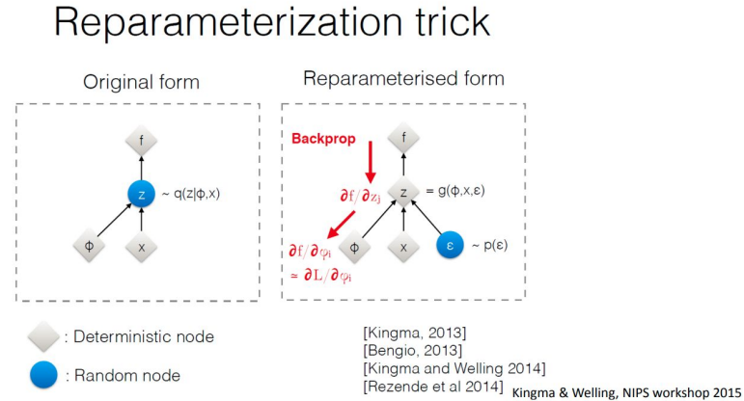
Variational AutoEncoder

Slide 20
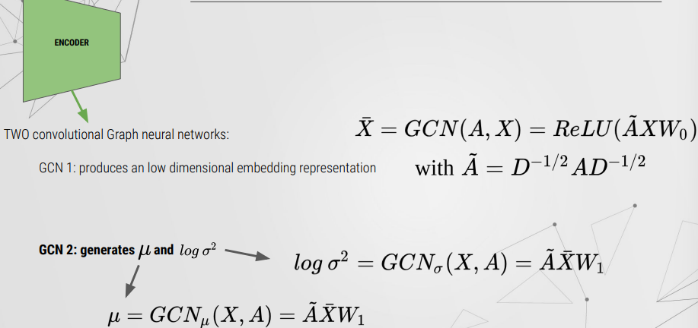
Variational AutoEncoder

Slide 21
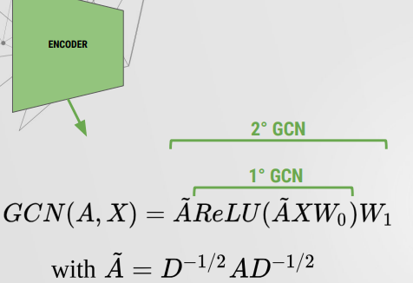
Variational AutoEncoder

Slide 22
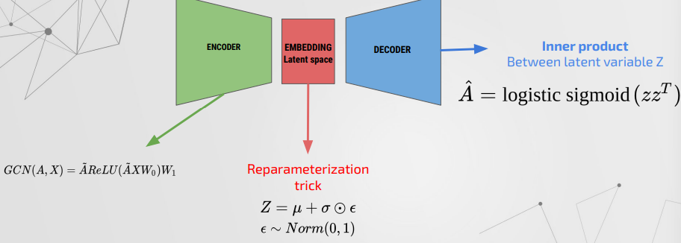
Variational AutoEncoder

